Slide 1
Chapter 14
Generics
Copyright © 2013 by The McGraw-Hill Companies, Inc. All rights reserved.

Slide 2
Generics (Parameterized Types)
Parameterized types enable you to create classes, interfaces, and methods in which the type of data on which they operate is specified as a parameter.
In old code, many classes and methods used Object as the type of data they operated on.
The disadvantage of the old approach is that explicit conversion with typecasting is often necessary to convert to the actual type of the data.
Copyright © 2013 by The McGraw-Hill Companies, Inc. All rights reserved.

Slide 3
Example Without Generics
class KVPair{
Object key, value;
Object getKey() { return key; }
Object getValue() { return value; }
void setKey(Object ob) { key = ob; }
void setValue(Object ob) { value = ob; }
}
Usage: KVPair pair = new KVPair();
pair.setValue("Address");
String v = (String) pair.getValue(); // typecast
Copyright © 2013 by The McGraw-Hill Companies, Inc. All rights reserved.

Slide 4
Example with Generics
class KVPair<T>{
T key, value;
T getKey() { return key; }
T getValue() { return value; }
void setKey(T ob) { key = ob; }
void setValue(T ob) { value = ob; }
}
Usage: KVPair<String> pair = new KVPair<String>();
pair.setValue("Address");
String v = pair.getValue(); // no typecast
Copyright © 2013 by The McGraw-Hill Companies, Inc. All rights reserved.

Slide 5
Example Explained
The <T> syntax indicates that T is a type parameter.
T is a placeholder for the actual type, which is provided when a KVPair object is created.
Use of generics allows us to avoid the type casting.
That is, generics makes type casts automatic and implicit, and therefore add type safety.
Copyright © 2013 by The McGraw-Hill Companies, Inc. All rights reserved.

Slide 6
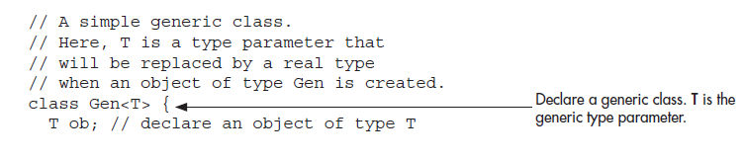
Another Generics Example

Slide 7
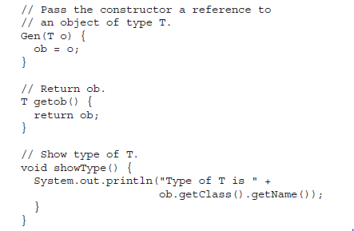

Slide 8
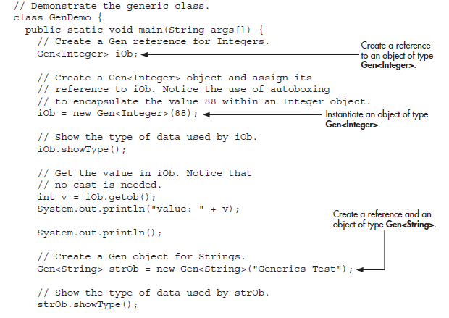

Slide 9
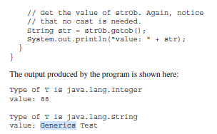

Slide 10
Generics Work Only with Reference Types
Gen<int> intOb = new Gen<int>(53);
// Error, can't use primitive type

Slide 11
Generic Types Differ Based on Their Type Arguments
iOb = strOb; // Wrong!
Even though both iOb and strOb are of type Gen<T>, they are references to different types because their type arguments differ. This is part of the way that generics add type safety and prevent errors.

Slide 12
Generics with two Type Parameters
You can use two or more type parameters:
class KVPair<K,V>{
K key;
V value;
K getKey() { return key; }
V getValue() { return value; }
void setKey(K ob) { key = ob; }
void setValue(V ob) { value = ob; }
}
USAGE: KVPair<String,Integer> pair =
new KVPair<String,Integer>();
Copyright © 2013 by The McGraw-Hill Companies, Inc. All rights reserved.

Slide 13
The General Form of a Generic Class
class class-name<type-param-list> { // ...
Here is the full syntax for declaring a reference to a generic class and creating a generic instance:
class-name<type-arg-list> var-name = new class-name<type-arg-list>(cons-arg-list);

Slide 14
Bounded Types
Used to restrict the types that can be used as type arguments in a parameterized type.
For example, a class/method that operates on numbers might only want to accept instances of Number or its subclasses.

Slide 15
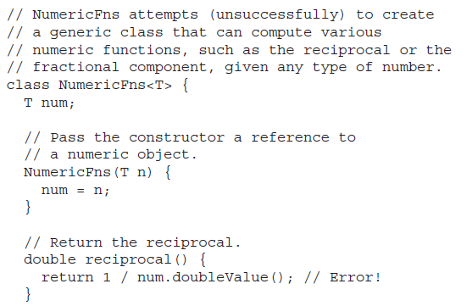

Slide 16
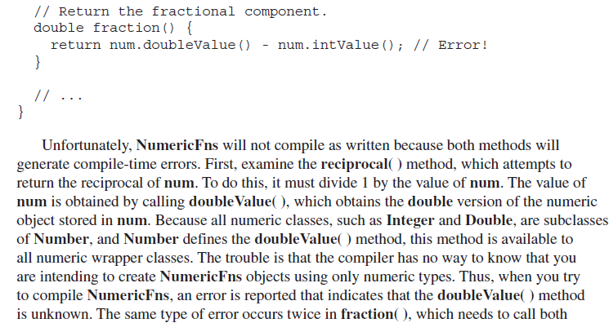

Slide 17
Bounded Types
To handle such situations, Java provides bounded types. When specifying a type parameter, you can create an upper bound that declares the superclass from which all type arguments must be derived. This is accomplished through the use of an extends clause when specifying the type parameter, as shown here:
<T extends superclass>
This specifies that T can be replaced only by superclass, or subclasses of superclass. Thus, superclass defines an inclusive, upper limit.

Slide 18
Bounded Types Explained
The notation T extends Number means that T must be a Number or a subclass of Number.
Other option:
<T, K extends T> means that the second type parameter must be the same as the first parameter or a subclass of the first parameter.
Copyright © 2013 by The McGraw-Hill Companies, Inc. All rights reserved.

Slide 19
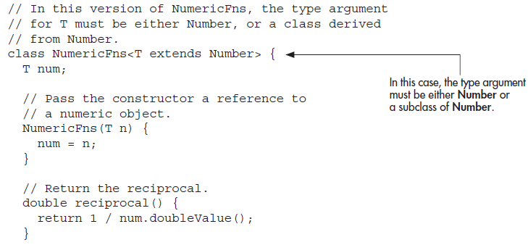

Slide 20
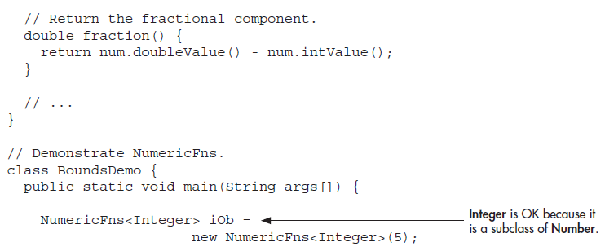

Slide 21
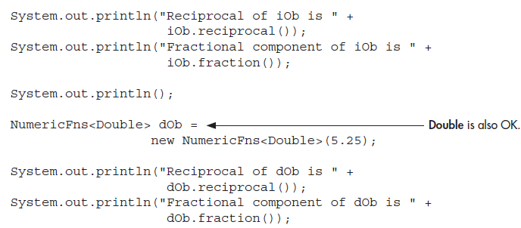

Slide 22
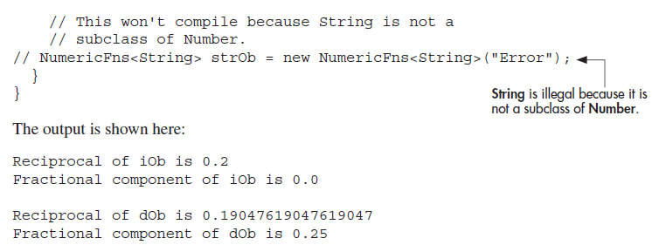

Slide 23
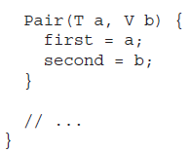


Slide 24
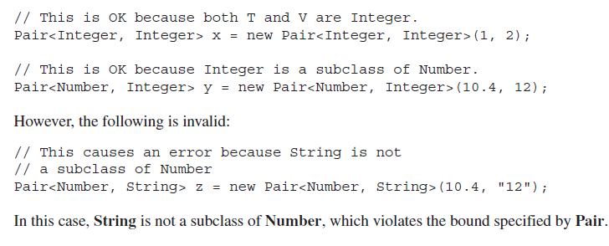

Slide 25
Using Wildcard Arguments
For example, if one object contains the Double value 1.25 and the other object contains the Float value –1.25, then absEqual( ) on these objects would return true.
One way to implement absEqual( ) is to pass it a NumericFns argument, and then compare the absolute value of that argument against the absolute value of the invoking object, returning true only if the values are the same.

Slide 26
Using Wildcard Arguments
NumericFns<Double> dOb = new NumericFns<Double>(1.25);
NumericFns<Float> fOb = new NumericFns<Float>(-1.25);
if(dOb.absEqual(fOb))
System.out.println("Absolute values are the same.");
else
System.out.println("Absolute values differ.");

Slide 27
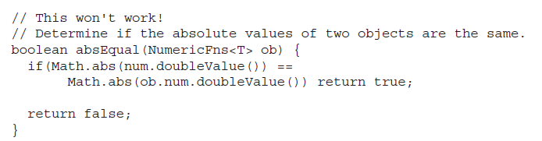
Using Wildcard Arguments

Slide 28
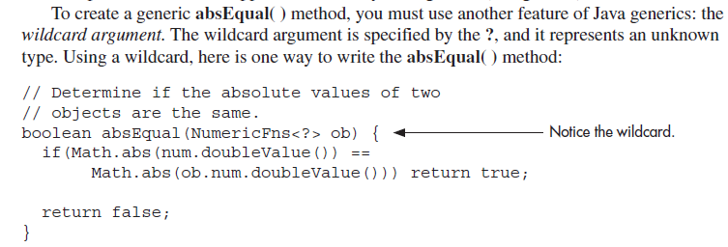
Using Wildcard Arguments

Slide 29
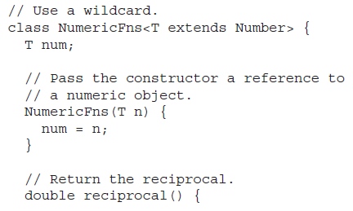
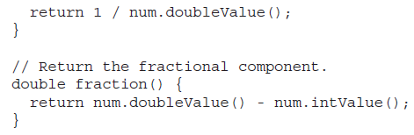

Slide 30
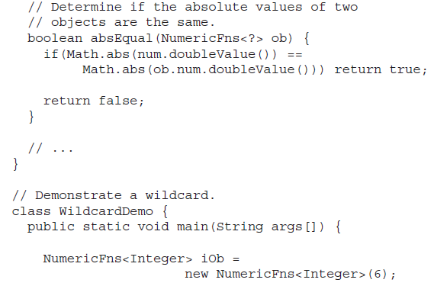

Slide 31
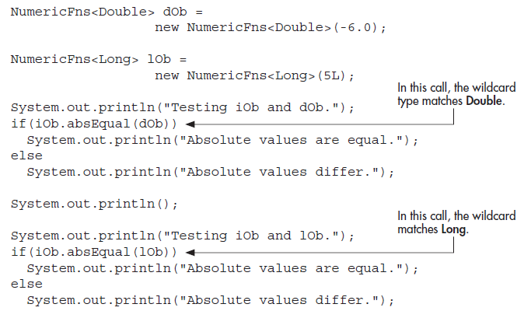


Slide 32
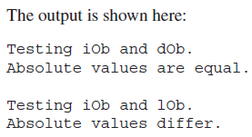
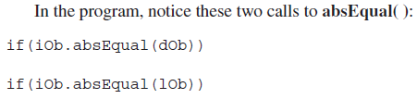
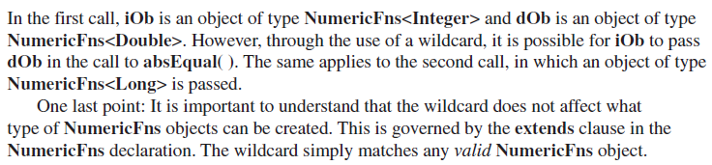

Slide 33
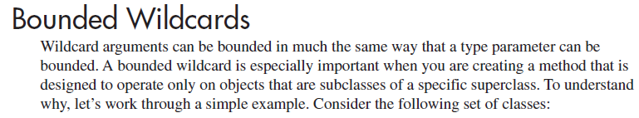
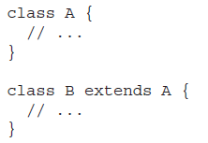
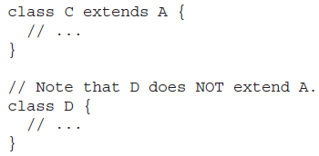

Slide 34
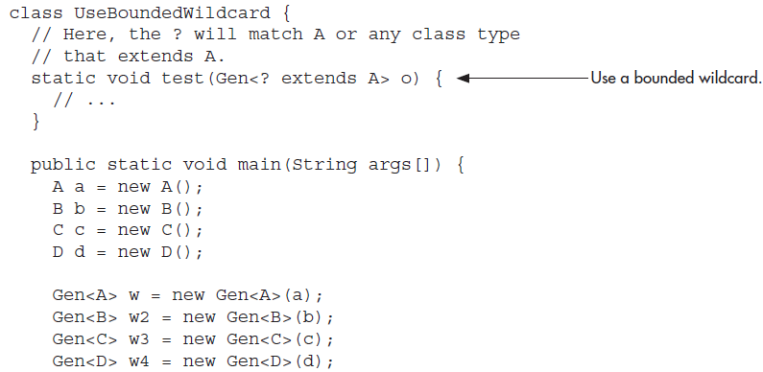

Slide 35
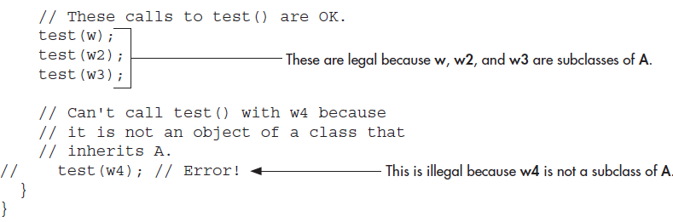


Slide 36
Upper bound / lower bound
Upper bound
<? extends superclass>
Lower bound
<? super subclass>

Slide 37
Generic Methods
You can write a single generic method declaration that can be called with arguments of different types.
Based on the types of the arguments passed to the generic method, the compiler handles each method call appropriately.
Following are the rules to define Generic Methods −
All generic method declarations have a type parameter section delimited by angle brackets (< and >) that precedes the method's return type ( < E > in the next example).
Each type parameter section contains one or more type parameters separated by commas. A type parameter, also known as a type variable, is an identifier that specifies a generic type name.
The type parameters can be used to declare the return type and act as placeholders for the types of the arguments passed to the generic method, which are known as actual type arguments.
Copyright © 2013 by The McGraw-Hill Companies, Inc. All rights reserved.

Slide 38
Following example illustrates how we can print an array of different type using a single Generic method −
public class GenericMethodTest {
// generic method printArray
public static < E > void printArray( E[] inputArray ) {
// Display array elements
for(E element : inputArray) {
System.out.print(“ “+ element);
}
System.out.println();
}
Copyright © 2013 by The McGraw-Hill Companies, Inc. All rights reserved.

Slide 39
public static void main(String args[]) {
// Create arrays of Integer, Double and Character
Integer[] intArray = { 1, 2, 3, 4, 5 };
Double[] doubleArray = { 1.1, 2.2, 3.3, 4.4 };
Character[] charArray = { 'H', 'E', 'L', 'L', 'O' };
System.out.println("Array integerArray contains:");
printArray(intArray); // pass an Integer array
System.out.println("\nArray doubleArray contains:");
printArray(doubleArray); // pass a Double array
System.out.println("\nArray characterArray contains:");
printArray(charArray); // pass a Character array
}
}
Copyright © 2013 by The McGraw-Hill Companies, Inc. All rights reserved.

Slide 40
Generic Constructor
A constructor can be generic, even if its class is not. For example, in the following program, the class Summation is not generic, but its constructor is.
The Summation class computes and encapsulates the summation of the numeric value passed to its constructor. Recall that the summation of N is the sum of all the whole numbers between 0 and N. Because Summation( ) specifies a type parameter that is bounded by Number, a Summation object can be constructed using any numeric type, including Integer, Float, or Double.
No matter what numeric type is used, its value is converted to Integer by calling intValue( ), and the summation is computed. Therefore, it is not necessary for the class Summation to be generic; only a generic constructor is needed.
Copyright © 2013 by The McGraw-Hill Companies, Inc. All rights reserved.

Slide 41
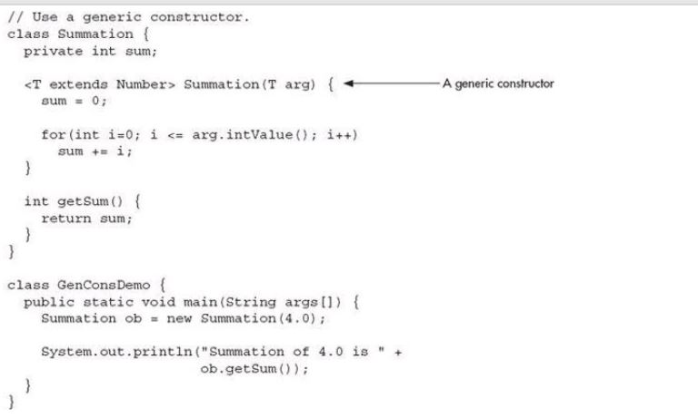
Generic Constructor
Copyright © 2013 by The McGraw-Hill Companies, Inc. All rights reserved.

Slide 42
Generic Constructor
class Summation{
private int sum;
<T extends Number> Summation(T arg) {
sum = 0;
for(int i=0; i<= arg.intValue(); i++)
sum += i;
}
int getSum() {
return sum;
}
}
public class GenConsDemo {
public static void main(String[] args) {
Summation ob = new Summation(4.0);
System.out.println("Summation of 4.0 is: "+
ob.getSum());
} }

Slide 43
Inheritance and Generics
Generic classes can be extended by generic subclasses.
The subclasses must pass type arguments up to the superclass that needs them.
Example:
class Sub<T,V> extends Sup<T> {
...
}
Copyright © 2013 by The McGraw-Hill Companies, Inc. All rights reserved.

Slide 44
A Simple Generic Class Hierarchy
class Gen<T> {
T ob;
Gen( T o) {
ob = o;
}
T getOb() {
return ob;
}
}
class Gen2<T> extends Gen<T> {
Gen2(T o) {
super(o);
}
}
public class GenClassHierarchy {
public static void main(String args[]){
Gen2<Integer> num;
num= new Gen2<Integer>(100);
System.out.println("Class Gen data member: “
+ num.getOb());
}
}

Slide 45
Class Hierarchy with non generic super class
class Gen2<T> extends NonGen {
T ob;
Gen2(T o, int i) {
super(i);
ob = o;}
T getOb() {
return ob;
} }
public class GenClassHierarchy1 {
public static void main(String args[]){
Gen2<Integer> num;
num= new Gen2<Integer>(100, 200);
System.out.println("Class NonGen data member: “
+ num.getNum());
System.out.println("Class Gen2 data member: “
+ num.getOb());
}
}
class NonGen {
int num;
NonGen( int i) {
num = i;
}
int getNum() {
return num;
}
}

Slide 46
Class Hierarchy with method overriding
class Gen<T> {
T ob;
Gen( T o) {
ob = o;
}
T getOb() {
System.out.println("Gen's GetOb(): ");
return ob;
} }
class Gen2<T> extends Gen<T> {
Gen2(T o) {
super(o); }
T getOb() {
System.out.println("Gen2's GetOb(): ");
return ob;
} }
public class OverrideDemo {
public static void main(String[] args) {
Gen<?> gRef;
Gen<Integer> iob = new Gen<Integer>(90);
Gen2<Integer> iob2 = new Gen2<Integer>(100);
gRef = iob;
System.out.println(gRef.getOb());
gRef = iob2;
System.out.println(gRef.getOb());
}

Slide 47
Interfaces and Generics
Interfaces can also be generic.
Any class that implements a generic interface must also be generic unless it implements a specific type of the interface.
Examples:
class C<T> implements I<T> { ... }
class D implements I<String> { ... }
Copyright © 2013 by The McGraw-Hill Companies, Inc. All rights reserved.

Slide 48
Interfaces and Generics
Generic interfaces are specified just like generic classes. Here is an example. It creates an interface called Containment, which can be implemented by classes that store one or more values. It declares a method called contains( ) that determines if a specified value is contained by the invoking object.
Copyright © 2013 by The McGraw-Hill Companies, Inc. All rights reserved.

Slide 49
interface Containment<T> {
boolean contains(T o);
}
class MyClass<T>implements Containment<T> {
T[] arrayRef;
MyClass(T[] o) {
arrayRef = o;
}
public boolean contains(T o){
for(T x : arrayRef)
if(x.equals(o)) return true;
return false;
}
}
public class GenIfDemo {
public static void main(String[] args) {
Integer x[] = {1, 2, 3};
MyClass<Integer> ob = new MyClass<Integer>(x);
if(ob.contains(2))
System.out.println("2 is in ob'");
else
System.out.println("2 is NOT in ob'");
if(ob.contains(5))
System.out.println("5 is in ob'");
else
System.out.println("5 is NOT in ob'");
//if(ob.contains(9.25)) //Illegal
//System.out.println("9.25 is in ob'");
}
}

Slide 50
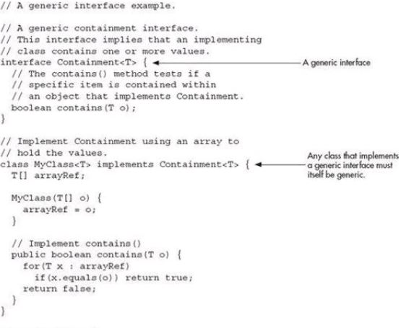
Interfaces and Generics
Copyright © 2013 by The McGraw-Hill Companies, Inc. All rights reserved.

Slide 51
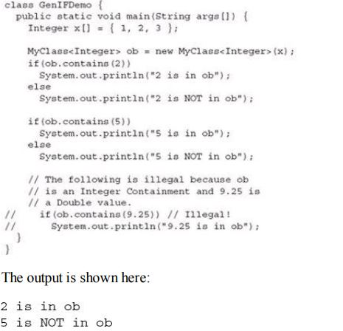
Interfaces and Generics
Copyright © 2013 by The McGraw-Hill Companies, Inc. All rights reserved.

Slide 52
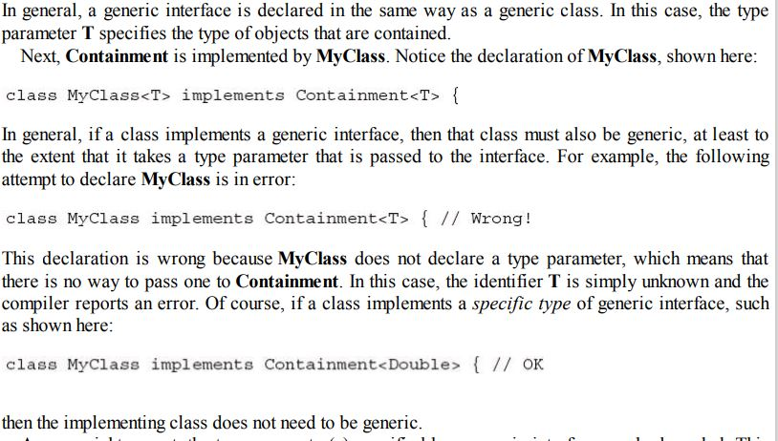
Interfaces and Generics
Copyright © 2013 by The McGraw-Hill Companies, Inc. All rights reserved.

Slide 53
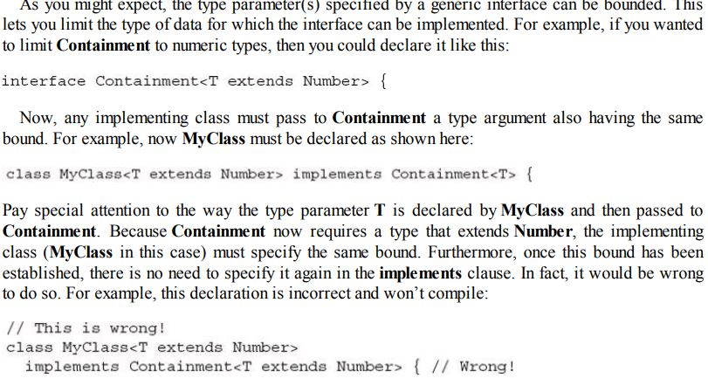
Interfaces and Generics
Copyright © 2013 by The McGraw-Hill Companies, Inc. All rights reserved.

Slide 54
Generic Restrictions
(i) Static variables and methods cannot use the type parameters declared by their generic class (but you can have static generic methods).
Example:
class C<T> {
static T x; // illegal
static T getX() { return x; } // illegal
static <W> void setX(W w) { // legal
...
}
}
Copyright © 2013 by The McGraw-Hill Companies, Inc. All rights reserved.

Slide 55
More Generic Restrictions
ii)You can't create an instance of a type parameter.
Example:
class C<T>
{
T x;
C()
{ x= new T(); // illegal
}
}
(iii) You can't can’t an array whose element type is the type parameter nor an array of type-specific generic references.
Example:
class C<T> {
T[] x ;
x = new T[10]; // illegal
C<String>[] data= new C<String>[10]; // illegal
C<?>[] data = new C<?>[10]; // legal
}

Slide 56
More Generic Restrictions
(iv) Generic Exception Restriction:
A generic class cannot extend Throwable.
This means that you cannot create generic exception classes.

Slide 57
Self Test
Can a primitive type be used as a type argument in Generics?
Show how to declare a class called FlightSched that takes two generic parameters.
Beginning with your answer to question 2, change FlightSched’s second type parameter so that it must extend Thread.
Now, change FlightSched so that its second type parameter must be a subclass of its first type parameter.
As it relates to generics, what is the ? and what does it do?
Can the wildcard argument be bounded?
A generic method called MyGen( ) has one type parameter. Furthermore, MyGen( ) has one parameter whose type is that of the type parameter. It also returns an object of that type parameter. Show how to declare MyGen( ).
Copyright © 2013 by The McGraw-Hill Companies, Inc. All rights reserved.

